Slide 1
CSP554 Big Data Technologies
Module 08
High Velocity Data Processing
Apache Kafka

Slide 2
High Level View

Slide 3
What is High Velocity Data Processing?
AKA Streaming or Stream Processing
So far we have focused on batch processing of data file
Sitting in HDFS, queried with Hive, transformed with Pig & Spark
Using Sqoop as an ingestion tool… sitting in databases
But how does new data get into Hadoop at the time it is generated?
New log entries from your web servers
New sensor data from you IoT systems
New transactions form oyur PoS systems
Stream processing lets you accept this data from external systems into your Hadoop cluster in real time
And you can even process it in real time on its arrival

Slide 4
Two Aspects of Stream Processing
Accepting data from different sources into Hadoop
Apache Kafka
Processing the data ASAP when it gets into there
Spark Structured Streaming

Slide 5
Key Concepts

Slide 6
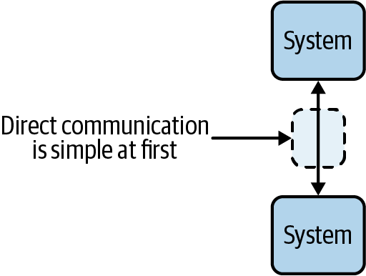
Communication | Point to Point
The most common communication pattern between systems is the synchronous, client-server model
In this context, we mean applications, databases, and anything else that reads and writes data over a network
The client-server model is simple at first, and involves direct communication between systems
For example, you may have an application that synchronously queries a database for some data

Slide 7
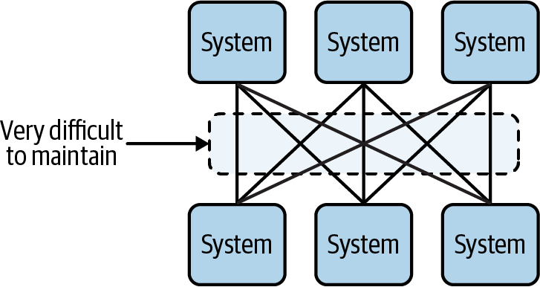
Communication | System to System
However, when more systems need to communicate, point-to-point communication becomes difficult to scale
The result is a complex web of communication pathways that can be difficult to reason about and maintain

Slide 8
Communication | System to System
Systems become tightly coupled because their communication depends on knowledge of each other
Synchronous communication leaves little room for error since there are no delivery guarantees if one of the systems goes offline
Receiving systems can easily be overwhelmed, since they don’t control the pace at which new requests or data comes in
Communication is not replayable, making it difficult to reconstruct the state of a system if there is a failure

Slide 9
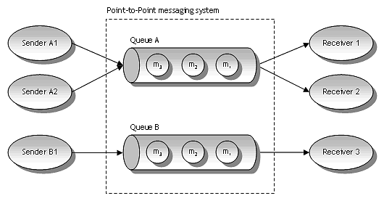
What is a Messaging System?
Middleware responsible for transferring data from one application to another
So the applications can focus on data and not worry about how to share it
Distributed messaging is based on the concept of reliable message queuing
Middleware (Messaging System)

Slide 10
What is a Messaging System?
Middleware responsible for transferring data from one application to another
So the applications can focus on data and not worry about how to share it
Distributed messaging is based on the concept of reliable message queuing
Middleware (Messaging System)

Slide 11
What is a Messaging System?
Two types of messaging patterns are possible in a messaging system
Point to point
Publish-subscribe

Slide 12
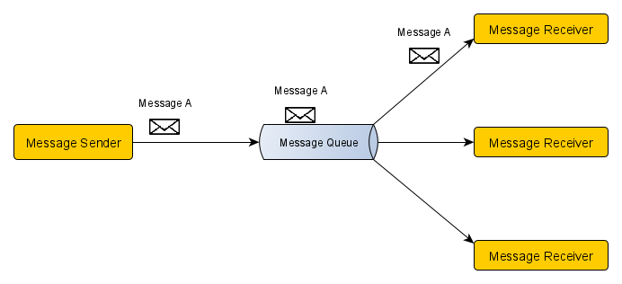
Messaging System | Point to Point
Each message sent from a message sender is consumed by only one consumer even if many message consumers are listening to the same message queue

Slide 13
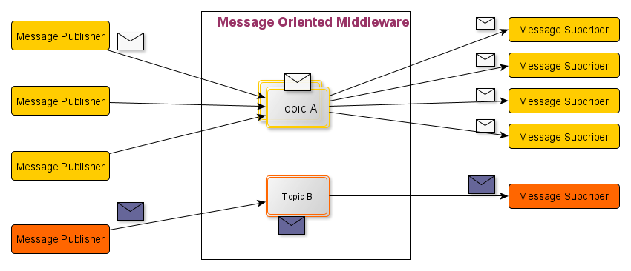
Messaging System | Publish & Subscribe
Each message sent by a message publisher to a topic is consumed by all subscribers registered with that topic
Message A
Message A
Message A
Message A
Message A
Message A
Message B
Message B
Message B

Slide 14
Publish-Subscribe Messaging System
One example of this model is Twitter
A publisher established an account (a topic)
Multiple subscriber then indicate interest in (subscribe) receiving tweets from that account
The publisher then enters (publish) one or more tweets (messages)
Each tweet (message) is then made available to every subscriber of that account (topic)

Slide 15
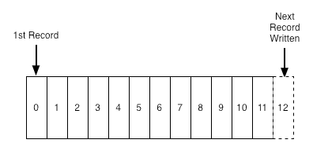
What Is a Log?
A log is perhaps the simplest possible storage abstraction
It is an append-only (and otherwise immutable) totally-ordered sequence of records ordered by time
Records are appended to the end of the log, and reads proceed left-to-right
Each entry is assigned a unique sequential log entry number

Slide 16
What Is a Log?
The ordering of records defines a notion of "time" since entries to the left are defined to be older then entries to the right. The log entry number can be thought of as the "timestamp" of the entry.

Slide 17
Logs in Databases (Commit Logs)
The most crucial structure for database recovery operations
Store all of the changes made to the database as they occur
Only reliable source of information about current state of the database
Used to recover consistent state of a database, upon failure

Slide 18
Detailed View

Slide 19
Apache Kafka
A general purpose publish and subscribe messaging system with each topic implemented as a distributed commit log
Developed at LinkedIn
Executes on a Hadoop cluster
More on “distributed commit logs” in a bit
Designed to be horizontally scalable making use of cluster compute and storage resources
Unlike traditional messaging systems that usually scale vertically

Slide 20
Apache Kafka
Can also be used as a solution to handling the ingestion of high volume and high velocity data
As part of a Lambda architecture speed layer
In this case each message can be thought of a a data records made available by data suppliers in real time
Data consumers can process data at a rate they can handle
Unprocessed data is stored in Kafka, in a durable and fault-tolerant manner, until the consumer is ready to process it.
This data is retained for a long and configurable length of time and is not deleted after is is sent to consumers, but can be read again
Consumers can rebuild their state anytime by rereading and reprocessing the events in a topic
If a consumer goes down, it will simply pick up from where it left off when it comes back online again

Slide 21
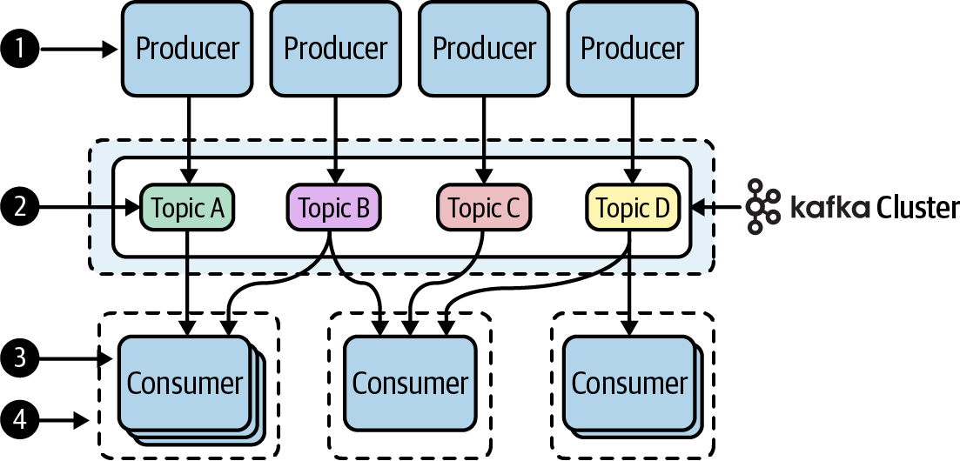
Apache Kafka
A producer publishes messages to a Kafka topic
Topics represent a logical collection of messages
Consumers subscribe to the Kafka topics to get the messages
Each consumer is a process or thread and these are organized into consumer groups

Slide 22
Kafka Architecture Initial Perspective
Publishers
(Producers)
App
App
App
Connectors
DB
Messages
Send to Topics
New/Changed
Record
Kafka Cluster
App
Stream
Processors
New/Changed
Record
DB
Messages
Read from Topics
App
App
App
Subscribers
(Consumers)

Slide 23
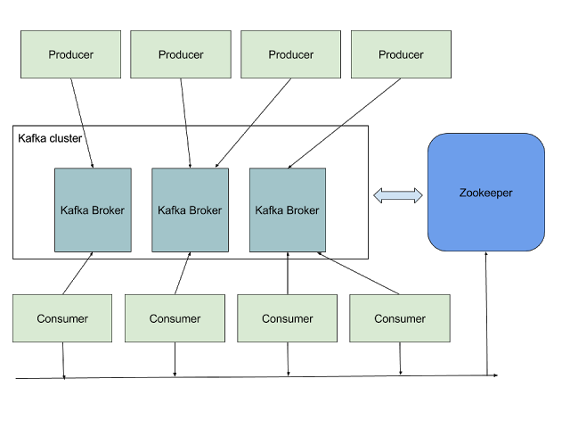
Kafka Architectural Landscape

Slide 24
Why Kafka?
Feature | Description
High Throughput | Support for up to millions of messages/s with relatively modest cluster computing hardware
Scalability | Horizontally scalable with no down time
Replication | Messages can be replicated across a cluster which provides load balancing and failure support
Durability | Provides support for persistence of messages even across network, disk and server failures
Integration | Kafka can be used with real time streaming systems like Spark Streaming and Storm

Slide 25
Messages and Batches
The unit of data within Kafka is called a message
If you are approaching Kafka from a database background, you can think of this as similar to a row or a record
A message is simply an array of bytes, as far as Kafka is concerned, so the data contained within it does not have a specific format or meaning to Kafka
Messages can have an optional bit of metadata which is referred to as a key
The key is also a byte array, and as with the message, has no specific meaning to Kafka
Keys are used when messages are to be written to partitions in a more controlled manner.

Slide 26
Messages and Batches
For efficiency, messages are written into Kafka in batches
A batch is just a collection of messages, all of which are being produced to the same topic and partition
An individual round trip across the network for each message would result in excessive overhead, and collecting messages together into a batch reduces this
This, of course, presents a tradeoff between latency and throughput…
The larger the batches, the more messages that can be handled per unit of time…
But the longer it takes an individual message to propagate
Batches are also typically compressed, which provides for more efficient data transfer and storage at the cost of some processing power

Slide 27
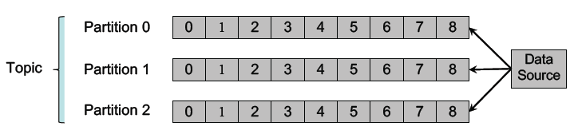
Topics and Logs
Messages are organized into topics, and each topic is split into partitions
Each partition is an immutable, time-sequenced log of messages on disk
Note that time ordering is guaranteed within, but not across, partitions

Slide 28
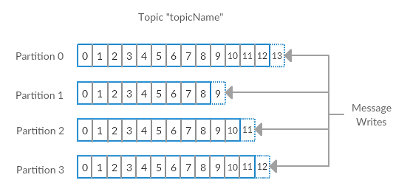
Topics and Logs
Here we show a topic with 4 partitions, with writes being appended to the end of each one
Partitions are also the way Kafka provides redundancy and scalability
Each partition can be hosted on a different server
This means that a single topic can be scaled horizontally across multiple servers…
To provide for performance far beyond the ability of a single server

Slide 29
Topics and Logs
Each partition is an ordered, immutable sequence of records that is continually appended to—a structured commit log
The records in the partitions are each assigned a sequential id number called the offset which uniquely identifies each record within the partition
The cluster retains all published records, whether or not they have been consumed using a configurable retention period
For example, if the retention policy is set to two days…
Then for the two days after a record is published, it is available for consumption after which it will be dropped to free up space
Kafka's performance is effectively constant with respect to data size so storing data for a long time is not a problem

Slide 30
Topics and Logs
The partitions in the log serve several purposes…
First, they allow the log to scale beyond a size that will fit on a single server
Each individual partition must fit on the server that hosts it
But a topic may have many partitions (distributed across multiple servers)
This allows a topic to handle an arbitrary amount of data
Second partitions act as the unit of parallelism—more on that in a bit

Slide 31
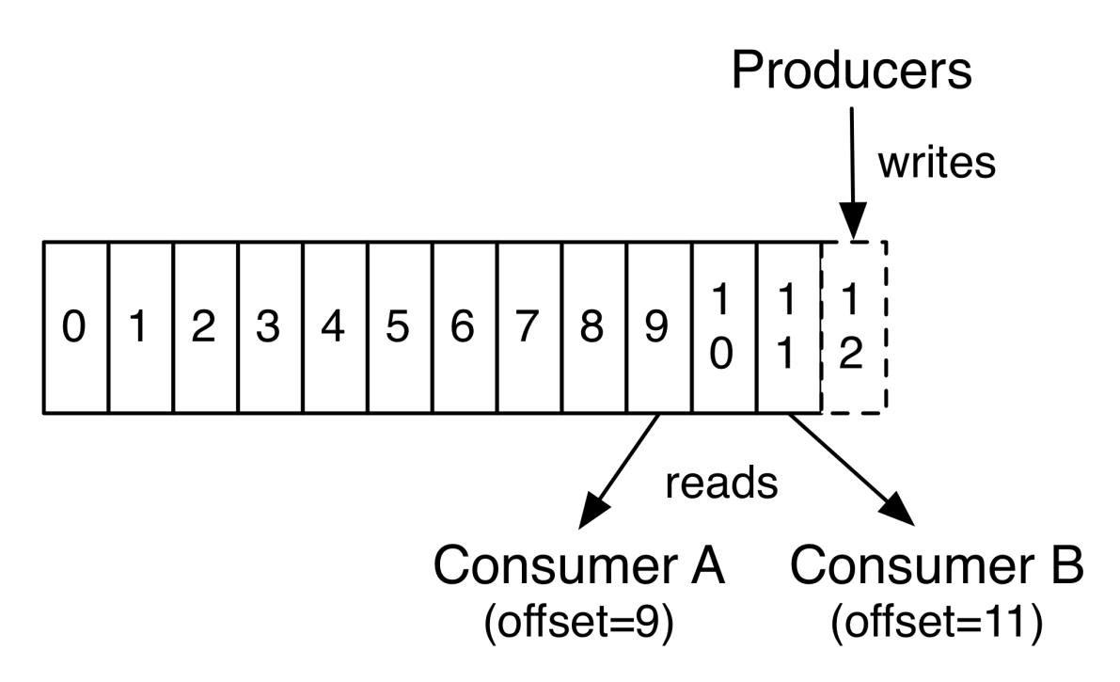
Topics and Logs
The only metadata retained on a per-consumer basis is the offset or position of that consumer in the log
This offset is controlled by the consumer and saved in a special Kafka topic
Normally a consumer will advance its offset linearly to the next as it reads records

Slide 32
Topics and Logs
But, in fact, since the position is controlled by the consumer it can consume records in any order it likes
For example a consumer can reset to an older offset to reprocess data from the past
Or the consumer can skip ahead to the most recent record and start consuming from "now"

Slide 33
Topics and Logs
So Kafka does not need complex logic to provide the consumers with their next message
This means that Kafka consumers are very cheap…
They can come and go without much impact on the cluster or on other consumers

Slide 34
Brokers and Clusters
Each Kafka instance belonging to a cluster is called a broker
The brokers primary responsibilities are…
To receive messages from producers
To assign offsets to these messages
To commit these messages to persistent storage
Each broker can easily handle thousands of partitions and millions of messages per second.
The partitions in a topic may be distributed across multiple brokers
This redundancy ensures high availability of messages

Slide 35
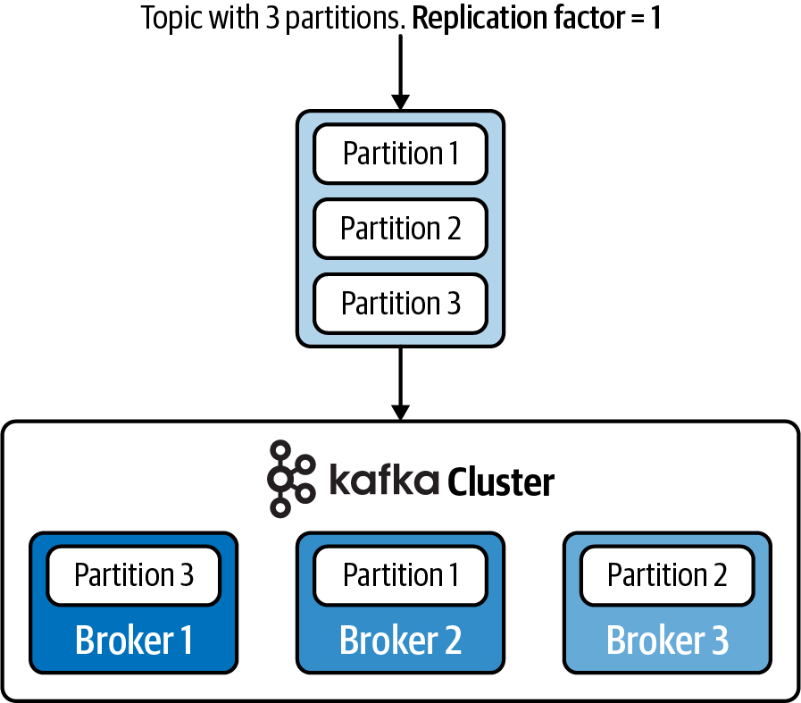
Brokers and Clusters
For example, a topic may have three partitions that are spread across three brokers
This allows topics to be quite large, since they can grow beyond the capacity of a single machine

Slide 36
Brokers and Clusters
Within a cluster of brokers, one will always function as the cluster controller
This controller is elected automatically from the live broker members of the cluster
The controller is responsible for administrative operations, including assigning partitions to brokers and monitoring for broker failures

Slide 37
Partitions
The partitions of each topic are distributed over servers in the Kafka cluster…
With each server handling data and requests for a share of the partitions
Each partition is replicated across a configurable number of servers for fault tolerance
While sending data, producers don’t mention the partition but consumers are aware of the available partitions
Kafka may use the message key to automatically group similar messages into a partition
This scheme enables Kafka to dynamically scale the messaging infrastructure

Slide 38
Partitions
Each partition has one server which acts as the "leader" and zero or more servers which act as "followers“
The leader handles all read and write requests for the partition while the followers passively replicate the leader
If the leader fails, one of the followers will automatically be promoted become to the new leader
Each server acts as a leader for some of its partitions and a follower for others
This allow I/O load to be well balanced within the cluster

Slide 39
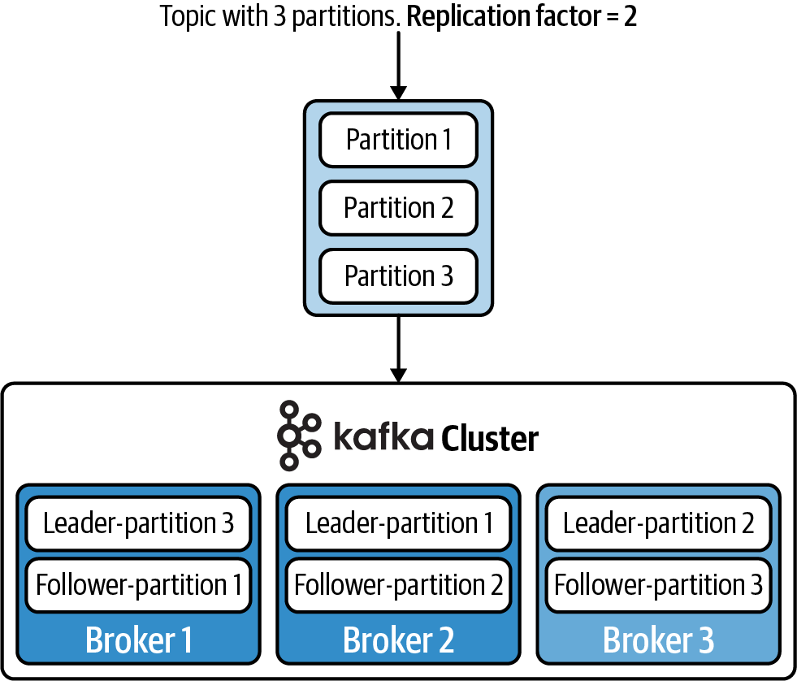
Partitions
To achieve fault tolerance and high availability, you can set a replication factor when configuring a topic
For example, a replication factor of 2 will allow the partition to be stored on two different brokers

Slide 40
Partitions
When a partition is replicated across multiple brokers, one broker will be designated as the leader, and will process all read/write requests for the partition
The other brokers that contain the replicated partitions are called followers, and they simply copy the data from the leader
If the leader fails, one of the followers will be promoted as the new leader

Slide 41
Partitions
As the load on a cluster increases over time, you can expand the cluster by adding even more brokers, and triggering a partition reassignment
This will allow you to migrate data from the old machines to a fresh, new machine.

Slide 42
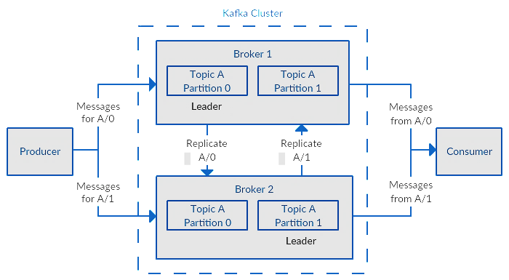
Partitions

Slide 43
Partitions
In replication, each partition of a message has n replicas and can afford n-1 failures to guarantee message delivery
Out of the n replicas, one replica acts as the lead replica for the rest of the replicas
ZooKeeper keeps the information about the lead replica and the current in-sync follower replica
The lead replica maintains the list of all in-sync follower replicas

Slide 44
The Role of ZooKeeper
Kafka uses Apache ZooKeeper as a distributed configuration store
It forms the backbone of Kafka cluster that continuously monitors the health of the brokers
When new brokers get added to the cluster, ZooKeeper will start utilizing it by creating topics and partitions on it
Initial versions of Kafka used ZooKeeper for storing the partition and offset information for each consumer
Starting from Kafka version 0.10, that information has moved to an internal Kafka topic

Slide 45
Producers
Producers publish data to the topics of their choice
The producer is responsible for choosing which record to assign to which partition within the topic
This can be done in a round-robin fashion simply to balance load
Or it can be done according to some partition function (say based on some key in the record)

Slide 46
Consumers
Consumers label themselves with a consumer group name…
And each record published to a topic is delivered to one consumer instance within each subscribing consumer group
If all the consumer instances have the same consumer group, then the records will effectively be load balanced over the consumer instances
If all the consumer instances have different consumer groups, then each record will be broadcast to all the consumer processes

Slide 47
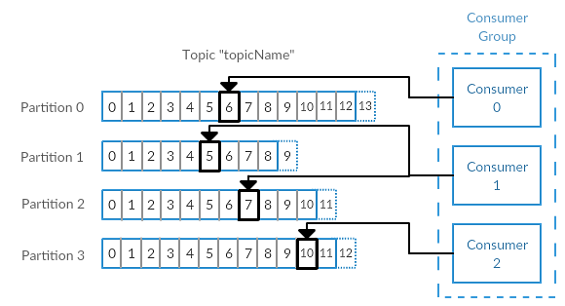
Consumers
Consumers are clients that consume records from a cluster
Consumers work together as part of a consumer group
This is one or more consumers that work together to consume a topic
The group assures each partition is only consumed by one member
Below there are three consumers in a single group consuming a topic
Two of the consumers are working from one partition each, while the third consumer is working from two partitions

Slide 48
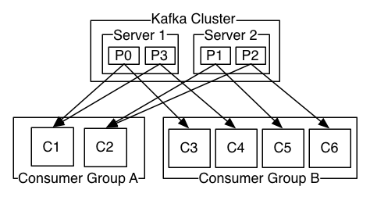
Consumers
Here is an example of a two server Kafka cluster hosting a four partition (P0-P3) topic with two consumer groups
Consumer group A has two consumer instances and group B has four

Slide 49
Consumers
Each group is composed of many consumer instances for scalability and fault tolerance
This is nothing more than an extension of typical publish-subscribe semantics…
But here the subscriber is a cluster of consumers instead of a single process
A consumer in a consumer group is assigned to a topic partition
Only one consumer within a consumer group can be assigned to a topic partition
But consumers from different consumer groups can be assigned to the same topic partition

Slide 50
Consumer Groups
Kafka consumers are typically part of a consumer group
When multiple consumers are subscribed to a topic and belong to the same consumer group…
Then each consumer in the group will receive messages from a different subset of the partitions in the topic

Slide 51
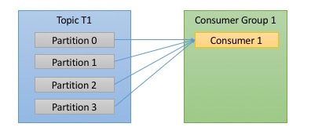
Consumer Groups
Lets take topic t1 with 4 partitions
Now suppose we created a new consumer, c1, which is the only consumer in group g1 and use it to subscribe to topic t1
Consumer c1 will get all messages from all four of t1 partitions

Slide 52
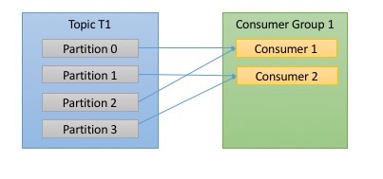
Consumer Groups
If we add another consumer, c2 to group g1, each consumer will only get messages from two partitions
Perhaps messages from partition 0 and 2 go to c1 and messages from partitions 1 and 3 go to consumer c

Slide 53
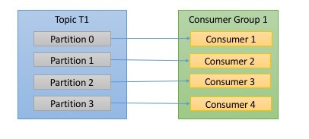
Consumer Groups
If g1 has 4 consumers, then each will read messages from a single partition

Slide 54
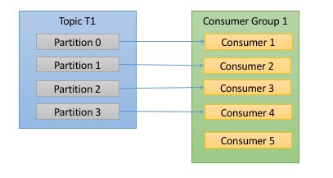
Consumer Groups
If we add more consumers to a single group with a single topic than we have partitions…
Then some of the consumers will be idle and get no messages at all.

Slide 55
Consumer Groups
The main way we scale consumption of data from a Kafka topic is by adding more consumers to a consumer group
It is common for Kafka consumers to do high latency operations such as write to a database or to HDFS, or a time-consuming computation on the data
In these cases, a single consumer can’t possibly keep up with the rate data flows into a topic, and adding more consumers that share the load by having each consumer own just a subset of the partitions and messages is our main method of scaling
This is a good reason to create topics with a large number of partitions - it allows adding more consumers when the load increases
Keep in mind that there is no point in adding more consumers than you have partitions in a topic - some of the consumers will just be idle.

Slide 56
Consumer Groups
It is very common to have multiple applications that need to read data from the same topic
In fact, one of the main design goals in Kafka was to make the data produced to Kafka topics available for many use-cases throughout the organization
In those cases, we want each application to get all of the messages, rather than just a subset
To make sure an application gets all the messages in a topic…
You make sure the application has its own consumer group

Slide 57
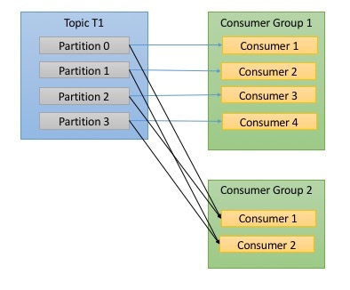
Consumer Groups
If we add a new consumer group 2 it will get messages in topic t1 independently of what group1 is doing

Slide 58
Guarantees
At a high-level Kafka gives the following guarantees:
Messages sent by a producer to a particular topic partition will be appended in the order they are sent
That is, if a record M1 is sent by the same producer as a record M2, and M1 is sent first, then M1 will have a lower offset than M2 and appear earlier in the log
A consumer instance sees records in the order they are stored in the log
For a topic with replication factor N, we will tolerate up to N-1 server failures without losing any records committed to the log

Slide 59
Using Kafka
There are many libraries allowing access to Kafka
Most widely used is the standard Java language library
But there is a Python library which we will explore
See https://github.com/dpkp/kafka-python

Slide 60
Using Kafka Core APIs
The Producer API allows an application to publish a stream of records to one or more Kafka topics.
Kafka.KafkaProducer(): A Kafka client that publishes records to the Kafka cluster
The producer is thread safe and sharing a single producer instance across threads will generally be faster than having multiple instances
The Consumer API allows an application to subscribe to one or more topics and process the stream of records produced to them
Kafka.KafkaConsumer(): Consume records from a Kafka cluster
Transparently handles the failure of servers in the Kafka cluster
Adapts as topic and partitions are created or migrate between brokers
Interacts with the assigned Kafka Group Coordinator node to allow multiple consumers to load balance consumption of topics

Slide 61
Using Kafka Simple message producer and consumer
Producer
Consumer
from kafka import KafkaProducer
from time import sleep
producer = KafkaProducer(
bootstrap_servers=['localhost:9092'])
producer.send('sample3', b'a_value')
sleep(5)
producer.close()
from kafka import KafkaConsumer
consumer = KafkaConsumer(
'sample3', auto_offset_reset='earliest',
bootstrap_servers=['localhost:9092'], consumer_timeout_ms=1000)
for message in consumer:
# value and key are raw bytes
# decode if necessary!
print ("%s:%d:%d: key=%s value=%s" % (message.topic, message.partition, message.offset, message.key, message.value))
consumer.close()

Slide 62
from kafka import KafkaProducer
from time import sleep
producer = KafkaProducer(bootstrap_servers=['localhost:9092'])
producer.send('sample3', b'a_value')
sleep(5)
producer.close()

Slide 63
Kafka Producer Overview
Here is an example of using a Kafka producer to send messages
From an implementation perspective the producer has…
A pool of buffer space that holds records (messages) that haven't yet been transmitted to the server
A background I/O thread responsible for turning these records into requests and transmitting them to the Kafka cluster
The example shows the principle phases of a Kafka producer’s lifecycle
Creating the producer
Sending one or more messages to Kafka brokers
Closing the producer to release any resources

Slide 64
Kafka Producer Phase 1—Create and configure the producer (default)
The following code snippet shows how to create a new KafkaProducer with a default configuration
from kafka import KafkaProducer
producer = KafkaProducer(bootstrap_servers=['localhost:9092’])

Slide 65
Kafka Producer Phase 1—Create and configure the producer (default)
A function encapsulating setting up a KafkaProducer including handling connection (and other) excpetions
def connect_kafka_producer():
_producer = None
try:
_producer = KafkaProducer(bootstrap_servers=['localhost:9092'])
except Exception as ex:
print('Exception while connecting Kafka')
print(str(ex))
finally:
return _producer

Slide 66
Kafka Producer Phase 1—Setting up the operational configuration (custom)
Set up to produce json format messages
{ ‘name’ : value }
from json import dumps
from kafka import KafkaProducer
producer = KafkaProducer(bootstrap_servers=['localhost:9092'],
value_serializer=lambda x: dumps(x).encode('utf-8’))
value_serializer=lambda x: dumps(x).encode(‘utf-8’)
function of how the data should be serialized before sending to the broker. Here, we convert the data to a json file and encode it to utf-8.

Slide 67
Kafka Producer Phase 2—Sending one or more messages to brokers (simple)
producer.send('test', b’a_value’)
producer.send('test’, value=b’a_value’, key=b’a_key’)
Topic name
Value, must be bytes
Key, must be bytes

Slide 68
Kafka Producer Phase 2—Sending one or more messages to brokers (simple)
from time import sleep
str_value = ‘a_string_value’
bytes_value=bytes(str_value, ‘utf-8’)
producer.send(‘test’, bytes_value)
sleep(5)
int_value = 5
bytes_value=bytes(int_value)
producer.send(‘test’, bytes_value)
sleep(5)
Convert a string value to bytes
Convert an int value to bytes

Slide 69
Kafka Producer Phase 2—Sending one or more messages to brokers (advanced)
Send json format messages
from time import sleep
from json import dumps
from kafka import KafkaProducer
producer = KafkaProducer(bootstrap_servers=['localhost:9092'],
value_serializer=lambda x: dumps(x).encode('utf-8’))
for e in range(1000):
data = {'number' : e}
producer.send('test', data)
sleep(5)

Slide 70
Kafka Producer Phase 2—Sending one or more messages to brokers (advanced)
# Asynchronous by default
future = producer.send('test', b'raw_bytes')
# Block for 'synchronous' sends
try:
record_metadata = future.get(timeout=10)
except KafkaError:
# Decide what to do if produce request failed...
log.exception()
pass
# Successful result returns assigned partition and offset
print (record_metadata.topic)
print (record_metadata.partition)
print (record_metadata.offset)

Slide 71
Kafka Producer Phase 2—Sending one or more messages to brokers (advanced)
def publish_message(producer_instance, topic_name, key, value):
try:
key_bytes = bytes(key, encoding='utf-8')
value_bytes = bytes(value, encoding='utf-8')
producer_instance.send(topic_name, key=key_bytes, value=value_bytes)
producer_instance.flush()
print('Message published successfully.')
except Exception as ex:
print('Exception in publishing message')
print(str(ex))

Slide 72
Kafka Producer Phase 2—Sending one or more messages to brokers
Next, the data is sent to a partitioner
If we specified a partitioner as a KafkaProducer() parameter it returns the partition to which to send the message
If we didn’t, the default partitioner will choose a partition for us

Slide 73
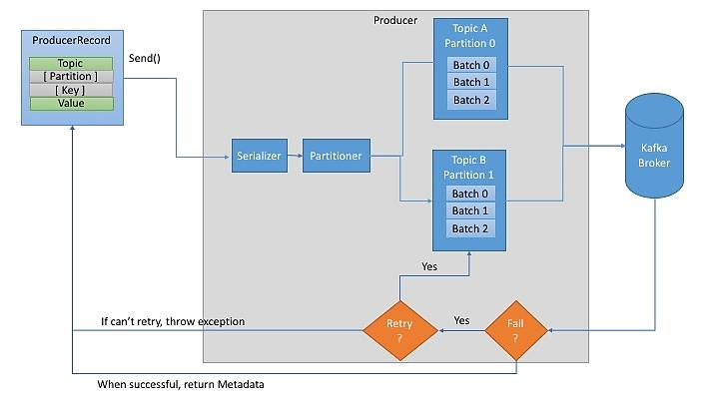
Kafka Producer Phase 3—Sending one or more messages to brokers

Slide 74
Kafka Producer Phase 3—Sending one or more messages to brokers
Once a partition is selected, the producer knows which topic and partition the record will go to
It then adds the record to a batch of records that will also be sent to the same topic and partition
A separate thread is responsible for sending those batches of records to the appropriate Kafka brokers.

Slide 75
Kafka Producer Phase 3—Closing the producer to release any resources
The producer has a pool of buffer space to holds records and a background thread for transmitting records
Failure to close the producer after use will leak these resources
producer.close();

Slide 76
Kafka Consumer Overview
The example shows the four principle phases of a Kafka consumer’s lifecycle
Creating and configure the kafka consumer
Retrieve sent messages from a topic partition
Close the consumer to release any resource

Slide 77
Kafka Consumer Phase 1—Creating the consumer (simple)
The following code snippet shows how to create a new consumer with a specified configuration
from kafka import KafkaConsumer
consumer = KafkaConsumer(
'test',
bootstrap_servers=['localhost:9092'],
auto_offset_reset='earliest’,
consumer_timeout_ms=10000,
group_id='my-group’)

Slide 78
Kafka Consumer Phase 1—Creating the consumer (simple)
By providing auto_offset_reset='earliest' you are telling Kafka to return messages from the beginning.
When set to ‘latest’, the consumer starts reading at the end of the log. When set to ‘earliest’, the consumer starts reading at the latest committed offset.
The parameter consumer_timeout_ms helps the consumer to disconnect after the certain period of time. Default block forever
The parameter group_id allows you to name the group your consumer is in. Default: None

Slide 79
Kafka Consumer Phase 1—Creating the consumer (advanced)
from kafka import KafkaConsumer
from json import loads
consumer = KafkaConsumer(
'test',
bootstrap_servers=['localhost:9092'],
auto_offset_reset='earliest',
enable_auto_commit=True,
group_id='my-group',
value_deserializer=lambda x: loads(x.decode('utf-8’)))
The value_deserializer deserializes the data into a common json format, the inverse of what our value serializer was doing

Slide 80
Kafka Consumer Phase 1—Creating the consumer
Kafka uses the concept of consumer groups to allow a pool of processes to divide the work of consuming and processing records
All consumer instances sharing the same group.id will be part of the same consumer group
Each consumer in a group can set the list of topics it wants to subscribe to through one of the subscribe APIs
Kafka will deliver each message in the subscribed topics to one process in each consumer group
This is achieved by balancing topic partitions between members in the consumer group…
So that each partition is assigned to exactly one consumer in the group
So if there is a topic with four partitions, and a consumer group with two processes, each process would consume from two partitions

Slide 81
Kafka Consumer Phase 2—Retrieve sent messages from a topic partition (simple)
from kafka import KafkaConsumer
consumer = KafkaConsumer(
'test',
bootstrap_servers=['localhost:9092'],
auto_offset_reset='earliest’,
consumer_timeout_ms=10000,
group_id='my-group’)
for message in consumer:
# message value and key are raw bytes -- decode if necessary!
# e.g., for unicode: `message.value.decode('utf-8')`
print ("%s:%d:%d: key=%s value=%s" % (message.topic, message.partition, message.offset, message.key, message.value))
A KafkaConsumer is a Python Iterable

Slide 82
Kafka Consumer Phase 2—Retrieve sent messages from a topic partition (simple)
Note, the consumer will wait for up to consumer_timeout_ms=10000 milliseconds for the next message
If no message is received the for loop will terminate
Without this timeout a consumer program will wait for the next message forever, or until you manually terminate it

Slide 83
Kafka Consumer Phase 3—Closing the consumer to release any resources
consumer.close()

Slide 84
Kafka Consumer Phase 2—Retrieve sent messages from a topic partition (advanced)
Read json format messages
from kafka import KafkaConsumer
from json import loads
consumer = KafkaConsumer(
'test',
bootstrap_servers=['localhost:9092'],
auto_offset_reset='earliest',
enable_auto_commit=True,
group_id='my-group',
value_deserializer=lambda x: loads(x.decode('utf-8’)))
for msg in consumer:
record = json.loads(msg.value)
print (record)
Deserialize each retreived message from bytes to a json object
Convert a json object into a Python dictionary

Slide 85
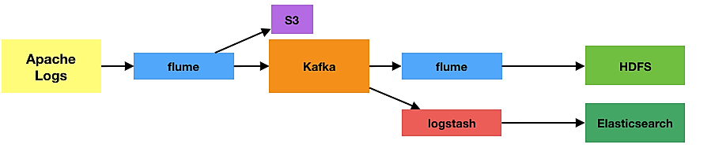
Kafka As Part of a Message Processing Pipeline

Slide 86
Kafka As Part of a Message Processing Pipeline Kappa Architecture
Speed Layer
Serving Layer
Raw
Physician
Record
Validated
Physician
Record
Validated
Physician
Records
Data
Source
Message
Producer
Data
Transformation
Message Consumer
Data Lake
(All
Physician
Records)
Data Analysts
Raw
Physician
Record
Raw
Physician
Record
Validated
Physician
Record
Validated
Physician
Record
Kakfa

